Slide 1
Objected Oriented Programming Concepts Using C++ & Data Structures Session 2

Slide 2
Intro
Programming : giving instructions
Programming Paradigm : Way of Thinking
C++ : Programming Language that supports procedural and object-oriented.
Data Structures : Way of organizing data

Slide 3
Topics covered
String & Streams
Properties
Access specifiers
Static Member
Inline Function
Constructors and Destructors
Types of constructors & destructors
Inheritance
Types of inheritance

Slide 4
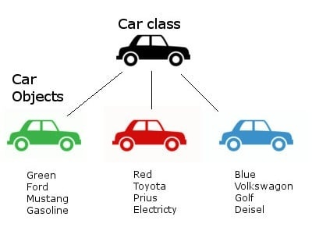
Properties of Class
Data Members
data variables
Member Functions
functions used to manipulate these variables

Slide 5
Access specifiers
define how the members of the class can be accessed
Specifiers | Class Boundary | Through Inhertiance | Through Objects
Private | Accessible | Not Accessible | Not Accessible
Protected | Accessible | Accessible | Not Accessible
Public | Accessible | Accessible | Accessible

Slide 6
Static Member
S

Slide 7
Inline Function
S

Slide 8
Constructors
S

Slide 9
Destructors
S

Slide 10
Types of Constructors & Destructors
S

Slide 11
Inheritance
S

Slide 12
Types of Inheritance
S

Slide 13
Example
class Student {
int rollNo ;
char [] name;
char [] address;
float[] marks;
float height;
Attendences attendences;
float calculatePercentage()
int getAttendenanceOfMonth(Month)
}
Object Creation :
Student s1 = new Student(); // s1.rollNo - 12
Student s2 = new Student(); // s2.rollNo - 23

